Slide 1
Final Exam Review
Part 2

Slide 2
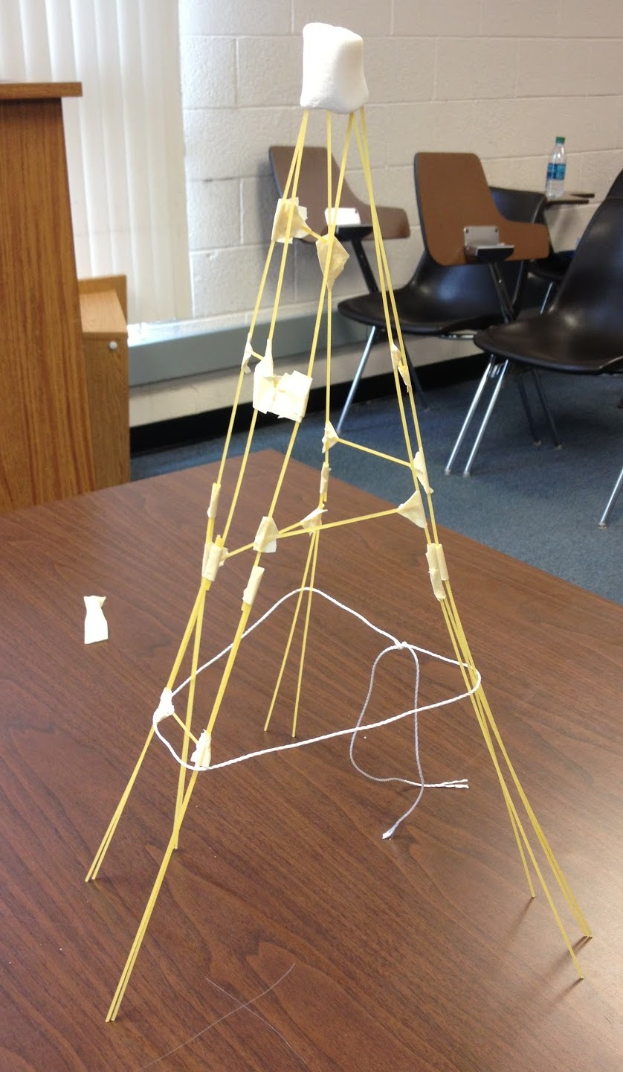
Iterative Design

Slide 3
Waterfall Model
REQUIREMENTS
DESIGN
IMPLEMENTATION
OH NO!
TESTING
MAINTENANCE
Notes:
More often than not you can have the “Oh no!” moment once you have done all that work.

Slide 4
Iterative Design
“Iterative design is a design methodology based on a cyclical process of idea generation, evaluation, and design improvement.” [Park and Wong, 2010. A Case Study of a Systematic Iterative Design Methodology and its Application in Engineering Education]

Slide 5
Where do we iterate?
REQUIREMENTS
DESIGN
EVALUATE
PROTOTYPE
IMPLEMENTATION
TESTING
USING
Notes:
Where else?

Slide 6
Data Pipeline
Question
Is it the right question?
Collect Data
Is it the right data for the question?
How hard/easy is it to collect?
Clean Data
What flaws exist in the data?
How do we address them?
Is it answerable?
Explore Data
Intuition
Use data
Communicate/Predict/…
Stats/Graphs/ML
Report on Findings
Visualize
Visualize
Notes:
Your midterm project asks you to iterate on your final visualization.

Slide 7
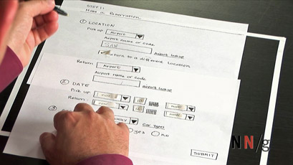
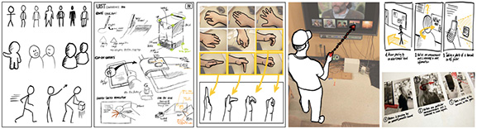
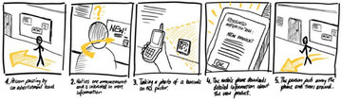
Prototyping Techniques
Sketching User Experiences: The Workbook by By Saul Greenberg, Sheelagh Carpendale, Nicolai Marquardt, Bill Buxton

Slide 8
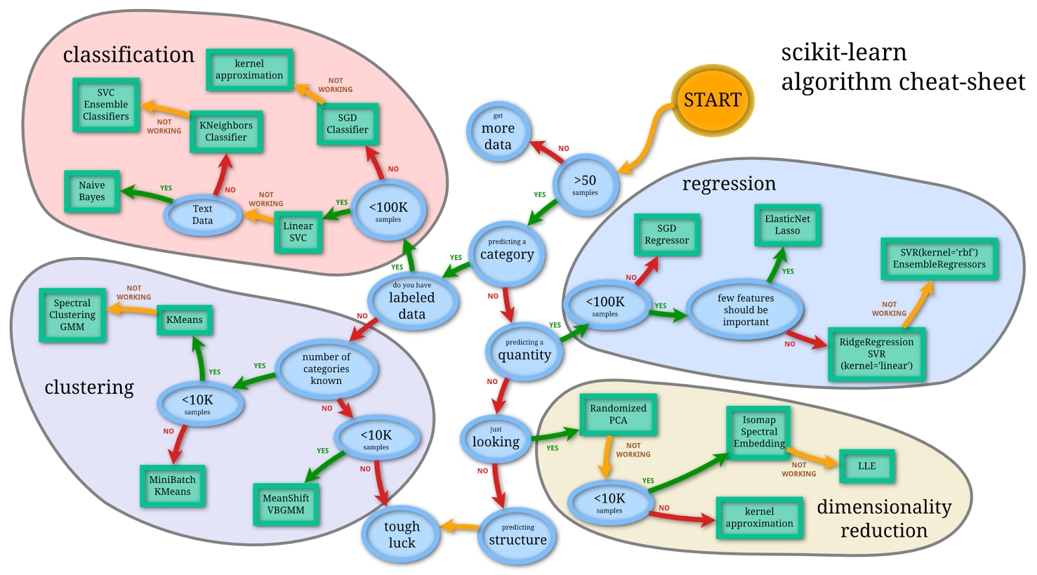
Machine Learning
http://www.quora.com/What-are-the-advantages-of-different-classification-algorithms

Slide 9
Machine Learning
Automatically or semi-automatically
Inducing concepts (i.e., rules) from data
Finding patterns in data
Explaining data
Making predictions
Supervised ML depends on labels and features
Labels typically expensive to acquire
Features key to success

Slide 10
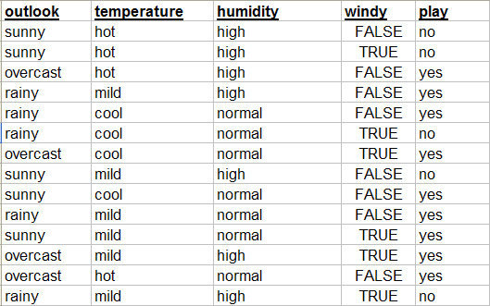
Training data: Multiple Examples

Slide 11
Including Features
Features

Slide 12
And Labels
Class

Slide 13
Feature Selection
Earlier indicated that feature selection is typically important to success
Very typical feature selection method: use information gain to “score” your features
Use the top N features ranked by information gain

Slide 14
Learned Classifiers
Training Time
Method to get Ground Truth
Training Data Set
Feature Gen
f₁ | f₂ | f₃ | … | Label
A | 42 | 17 | … | Yes
C | 78 | 25 |  | No
X | 32 | 4 |  | Yes
Learner
Sensors
Classifier

Slide 15
Learned Classifiers
Run/Classify Time
Feature Gen
Sensors
Classifier
Class

Slide 16
Learned Classifiers
Training Time
Training Data Set
Feature Gen
f₁ | f₂ | f₃ | … | Label
A | 42 | 17 | … | Yes
C | 78 | 25 |  | No
X | 32 | 4 |  | Yes
Learner
Sensors
Many learning algorithms to choose from
A few of the simplest ones tend to perform well
Naïve Bayes
Decision Trees
Regression-based Models (for continuous)
Classifier

Slide 17
Learned Classifiers
Training Time
Training Data Set
Feature Gen
f₁ | f₂ | f₃ | … | Label
A | 42 | 17 | … | Yes
C | 78 | 25 |  | No
X | 32 | 4 |  | Yes
Learner
Sensors
Many possible features
Different sensors
Multitude of ways to generate features
Many ways to transform and combine features
Some much more predictive / useful than others
→ “Feature selection” tends to be very important
Classifier

Slide 18
Learned Classifiers
Training Time
Training Data Set
Feature Gen
f₁ | f₂ | f₃ | … | Label
A | 42 | 17 | … | Yes
C | 78 | 25 |  | No
X | 32 | 4 |  | Yes
Learner
Sensors
Labeled data tends to be hard to come by
Tend to be expensive to gather or just non-existent
Typically need a lot of data to do well
Prefer 1000s of training samples
Classifier

Slide 19


Slide 20
Train
Test

Slide 21
Best Approach
Optimization set (for tuning parameters; etc.)
Training set (for training your classifier)
Testing set (for calculating scores)
In practice: Not enough labeled data!
Never give up on the optimization set, just make it smaller
Notes:
Called ‘holdout validation’ : need a large enough holdout set so you can trust the result (and this reduces your training data which you almost never have enough of)

Slide 22
Best Practices
Divide your data
Optimization set (for tuning parameters; etc.)
Training set (for training your classifier)
Testing set (for calculating scores)
Estimate performance on training set (10 fold cross)
Test set is for reporting
All data is for producing a classifier to use in the real world
Read your data. Explore it. Try things out (feature sets, algthm parameters). But do it all on the optimization set.
Notes:
Called ‘holdout validation’ : need a large enough holdout set so you can trust the result (and this reduces your training data which you almost never have enough of)

Slide 23
How can we tell if classifier is doing well?
Accuracy = (TP+TN)/(TP+FP+FN+TN)
Precision = TP/(TP+FP)
Recall = TP/(TP+FN)
PREDICTED/ACTUAL | FEMALE | MALE
FEMALE | TRUE POSITIVE | FALSE POSITIVE
MALE | FALSE NEGATIVE | TRUE NEGATIVE
Notes:
What do you want to be higher: precision or recall?
(Answer: it depends on the problem. Do not give the answer. Show ROC curve and Precision/Recall Curve and then ask again).

Slide 24
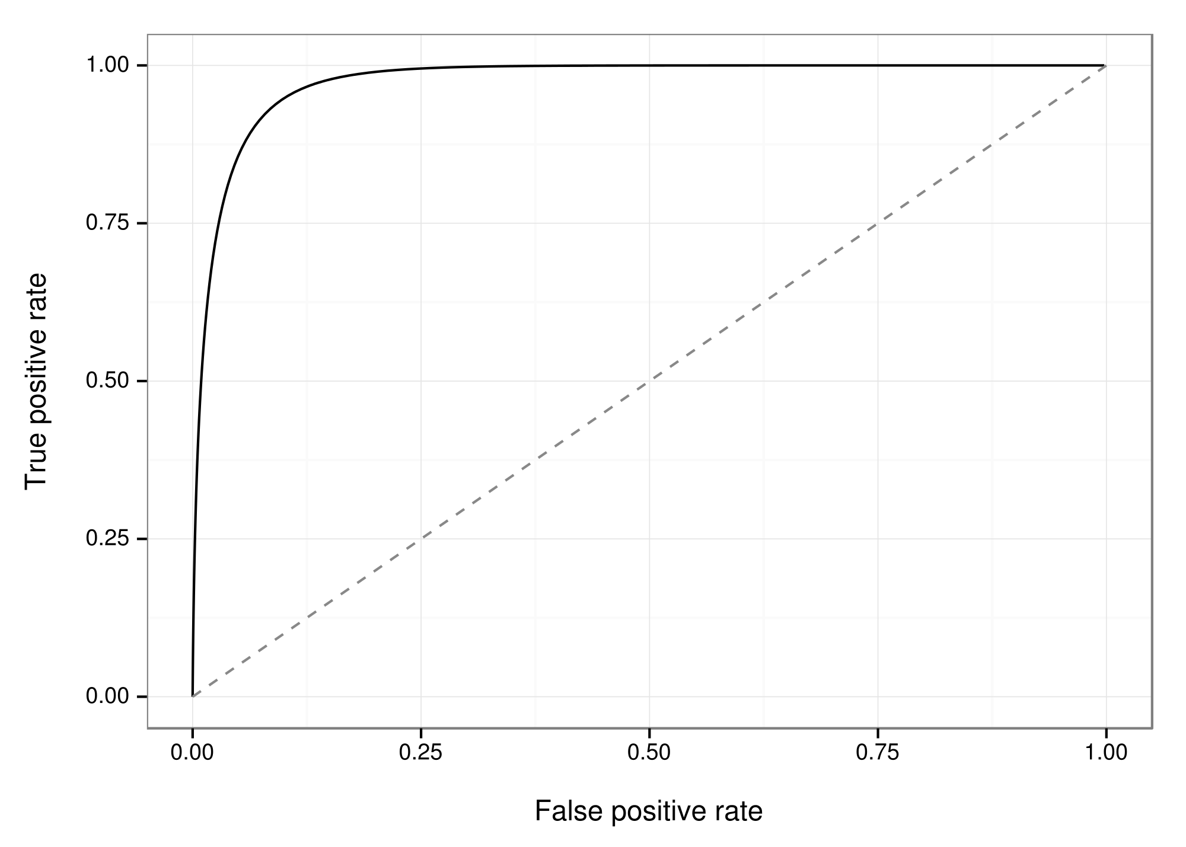
How can we tell if classifier is doing well?
ROC Curve:
USE AREA UNDER THE CURVE
AS A METRIC
By EpochFail (Own work) [CC BY-SA 4.0 (http://creativecommons.org/licenses/by-sa/4.0)], via Wikimedia Commons
Notes:
How do we plot this curve?

Slide 25
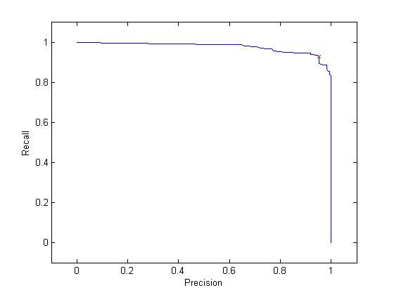
How can we tell if classifier is doing well?
Precision/Recall Curve:
https://web.stanford.edu/group/vista/cgi-bin/wiki/index.php/Misprint_development_notes
Notes:
How do we plot this curve?

Slide 26
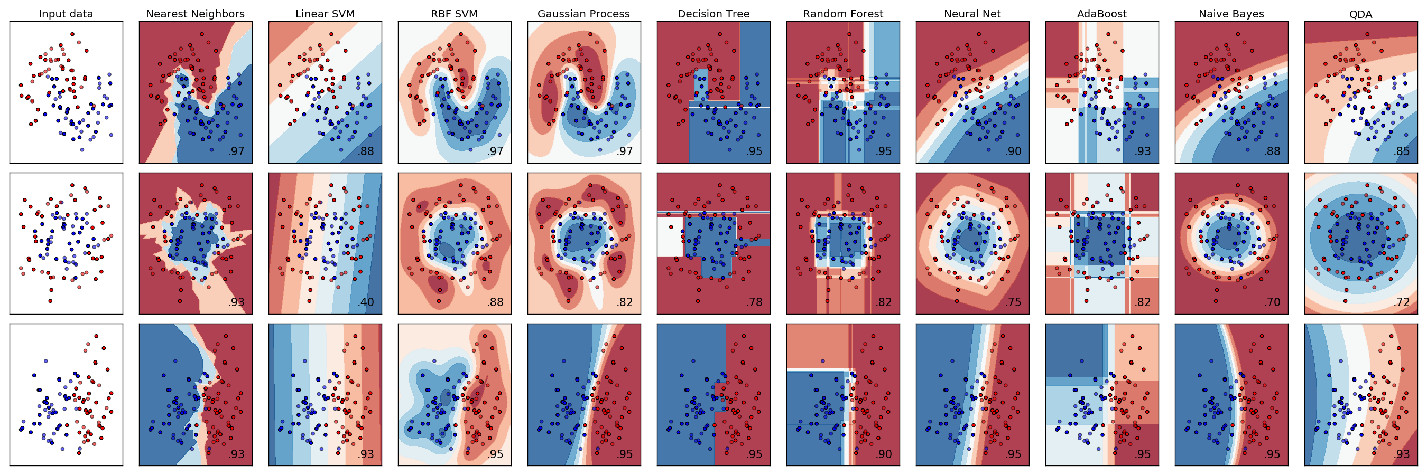
Selecting algorithms
http://www.quora.com/What-are-the-advantages-of-different-classification-algorithms

Slide 27
 | Decision Trees | Naïve Bayes | SVM* | Rule Learners
Accuracy in general | ** | * | **** | **
Speed of learning given f and n | *** | **** | * | **
Tolerance of missing values | *** | **** | **** | **
Tolerance of irrelevant features | *** | ** | *** | **
Tolerance of interdependent fs | ** | * | *** | **
Discrete/Binary/Continues fs | **** | *** (!cont) | ** (!disc) | *** (!cont)
Tolerance to noise | ** | *** | ** | *
Avoiding overfitting | ** | *** | ** | **
Intelligibility | **** | **** | * | *
Also see: http://www.lauradhamilton.com/machine-learning-algorithm-cheat-sheet
Notes:
Svm is a ‘better’ version of regression for classification
F = num features; n = num instances
Also see: http://www.lauradhamilton.com/machine-learning-algorithm-cheat-sheet

Slide 28
How do we handle big data?
Batch mode : Gradient Descent
w_{j} = w_{i} - η Δ(w) over the entire data S
Incremental mode: stochastic gradient descent
w_{j} = w_{i} - η * approximation of Δ(w)
can approximate Batch Gradient Descent arbitrarily closely if η is small enough
supports online learning
easily parallelized
Not guaranteed to reach global minimum

Slide 29
Usable Machine Learning
Difficulties with machine learning
Understand what is going on
Control what is going on
Potential cost to user
Corrections
Features
[Labels]

Slide 30
Types of Feedback
Feedback: crucial to user’s understanding of how a system works and helping guide future action
What did the system do?
What if I do W, what will the system do?
Why did the system do X?
Why did the system not do Y
How do I get the system to do Z?

Slide 31
Integrating ML into Interactive Systems
Real-time Classification
Prediction
Recommendation
Requires to have a trained model
Send unseen data to model for prediction
Notes:
What does it mean to integrate ML?

Slide 32
Integrating ML into Interactive Systems
Assessing performance over time
Continued learning:
Online learning
Active learning

Slide 33

Correlation and Causality
Past experience leads to expectation
Hear noise
Go to window
to verify
Prediction was false
Only with empirical evidence, can we make and test predictions
Adapted from class by Samantha Kleinberg

Slide 34
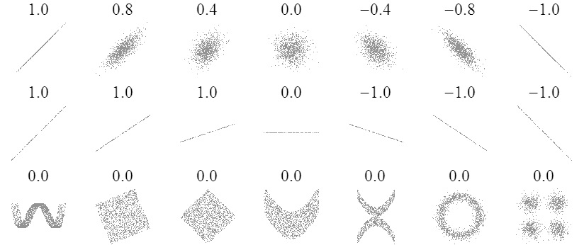
Sample Correlations
Adapted from: http://www.sjsu.edu/people/steven.macramalla/courses/stats95/s1/lecture 10
34

Slide 35
Residual Analysis for Linearity
y
y
x
x
residuals
x
x
residuals
✓
Not Linear
Linear
Slide from: Statistics for Managers Using Microsoft® Excel 4th Edition, 2004 Prentice-Hall

Slide 36
Residual Analysis for Constant Variance (Homoscedasticity)
y
y
x
x
residuals
x
x
residuals
✓
Non-constant variance
Constant variance
Slide from: Statistics for Managers Using Microsoft® Excel 4th Edition, 2004 Prentice-Hall

Slide 37
Residual Analysis for Independence
✓
Not Independent
Independent
residuals
X
residuals
X
residuals
X
Slide from: Statistics for Managers Using Microsoft® Excel 4th Edition, 2004 Prentice-Hall

Slide 38
Correlation is not Causation
There is a 0.91 correlation between ice cream consumption and drowning deaths.
Does eating ice cream cause drowning?
Does grief cause us to eat more ice cream?
Adapted from: http://www.sjsu.edu/people/steven.macramalla/courses/stats95/s1/lecture 10

Slide 39
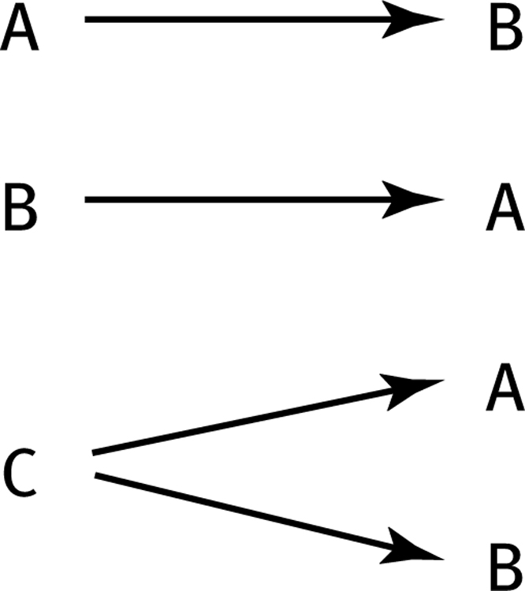
How can we test these associations?
Three Possible Causal Explanations for a Correlation
Adapted from: http://www.sjsu.edu/people/steven.macramalla/courses/stats95/s1/lecture 10

Slide 40
Common Statistical Tests: T-Test
T-Test
Tests for difference between two samples
Best used to determine what is ‘worthy of a second look’
Limited in its applicability to normal, independent data
The more implausible the hypothesis, the greater chance that it is a ‘false alarm’
Does not help to document effect size [the actual difference between groups], just effect likelihood
Susceptible to ‘data dredging’
Varied tests looking for a significant result
Adjustments mid experiment
Notes:
changes in a few data-analysis decisions can increase the false-positive rate in a single study to 60%.

Slide 41
Is there a difference?
m₁
m₂
p
x

Slide 42
95% confidence interval
95% confidence interval
m₁
m₂
p
x

Slide 43
Is there a difference?
m₁
m₂
p
x

Slide 44
95% confidence interval
95% confidence interval
m₁
m₂
p
x

Slide 45
Flaws with p values
Does not tell us the likelihood something is true. It only lets us reject or accept a hyp.
Gives a yes or no answer: Either the null hypothesis is rejected (the result would be unlikely [defined by α] in a world where the null hypothesis was true) or it cannot be rejected
Doesn’t take prior knowledge into account
Based on assumed ‘average’ sample

Slide 46
Potential Errors
 | Actually is: Same as Population | Actually is: Different than Population
Decision: is Same | H₀ (null): No difference | False negative
Decision: is Different | False positive | H₁: Real difference

Slide 47
Could our Estimate Be Wrong?
 | Actually is: Same as Population | Actually is: Different than Population
Decision: is Same | H₀ (null): No difference | False negative
Decision: is Different | False positive | H₁: Real difference
Erroneously detect a difference (Type I error). Directly affected by α: at .05 we make a Type I error 5 out of 100 tries. .01 reduces this error to 1 out of 100 tries.

Slide 48
Could our Estimate Be Wrong?
 | Actually is: Same as Population | Actually is: Different than Population
Decision: is Same | H₀ (null): No difference | False negative
Decision: is Different | False positive | H₁: Real difference
Fail to detect a true difference (Type II error) Indirectly affected by α: Depends on the size of the mean difference and the sample size.

Slide 49
Bayesian Analysis: an example
A clinician developed a test for a disease
The hit rate is 99%, meaning P(+ | sick) = .99
False alarm rate is .5%, meaning P(+ | healthy) = .005
A patient’s test comes back positive. Do you treat?

Slide 50
An example
Test Result | Disease |  | Marginal (test result)
T= + 99% hit rate ½ % false pos
T = -
Marginal(disease) | P(sick) = .o1 | P(healthy) = 1 - .01 | 1
Notes:
Base rate of disease: .001
Test ‘hit rate’ is 99%
False alarm rate: ½ %

Slide 51
An example
Test Result | Disease |  | Marginal (test result)
T= + 99% hit rate ½ % false pos | P(+|sick)p(sick) = .99 * .01 | P(+|healthy)(p(healthy) = .005 * (1 - .01) | = ∑p(+|θ)p(θ)
T = - | P(-|sick)p(sick) = (1 – .99) * .01 | P(-|healthy)p(healthy) = (1 - .005) * (1 - .01) | = ∑p(-|θ)p(θ)
Marginal(disease) | P(sick) = .01 | P(healthy) = 1 - .01 | 1
Notes:
Base rate of disease: .001

Slide 52
An example
Test Result | Disease |  | Marginal (test result)
T= + 99% hit rate ½ % false pos | P(+|sick)p(sick) = .99 * .01 | P(+|healthy)(p(healthy) = .005 * (1 - .01) | = ∑p(+|θ)p(θ)
T = - | P(-|sick)p(sick) = (1 – .99) * .01 | P(-|healthy)p(healthy) = (1 - .005) * (1 - .01) | = ∑p(-|θ)p(θ)
Marginal(disease) | P(sick) = .01 | P(healthy) = 1 - .01 | 1
P(+|θ=sick) p (θ=sick)
.99*.01
P(θ=sick|+) = = = .6666
∑p(+|θ)p(θ)
.99*.1 + .005*(1-.01)
Notes:
Base rate of disease: .001

Slide 53
Reconsidering what we know about disease
Test Result | Disease |  | Marginal (test result)
T= + 99% hit rate ½ % false pos
T = -
Marginal(disease) | P(sick) = .001 | P(healthy) = 1 - .001 | 1
Notes:
Base rate of disease: .001
Test ‘hit rate’ is 99%
False alarm rate: ½ %

Slide 54
Reconsidering what we know about disease
Test Result | Disease |  | Marginal (test result)
T= + 99% hit rate ½ % false pos | P(+|sick)p(sick) = .99 * .001 | P(+|healthy)(p(healthy) = .005 * (1 - .001) | = ∑p(+|θ)p(θ)
T = - | P(-|sick)p(sick) = (1 – .99) * .001 | P(-|healthy)p(healthy) = (1 - .005) * (1 - .001) | = ∑p(-|θ)p(θ)
Marginal(disease) | P(sick) = .001 | P(healthy) = 1 - .001 | 1
Notes:
Base rate of disease: .001

Slide 55
Reconsidering what we know about disease: The impact of priors
Test Result | Disease |  | Marginal (test result)
T= + 99% hit rate ½ % false pos | P(+|sick)p(sick) = .99 * .001 | P(+|healthy)(p(healthy) = .005 * (1 - .001) | = ∑p(+|θ)p(θ)
T = - | P(-|sick)p(sick) = (1 – .99) * .001 | P(-|healthy)p(healthy) = (1 - .005) * (1 - .001) | = ∑p(-|θ)p(θ)
Marginal(disease) | P(sick) = .001 | P(healthy) = 1 - .001 | 1
P(+|θ=sick) p (θ=sick)
.99*.001
P(θ=sick|+) = = = .1654
∑p(+|θ)p(θ)
.99*.001 + .05*(1-.001)
Notes:
1.9% !!! This is the importance of priors

